Slide 1
Further Partial Differential Equations
Ian Griffiths
ian.griffiths@maths.ox.ac.uk
Notes:
We will consider two topics –
Similarity solutions and free boundary problems (and maybe boundary layers)
Style of course:
Useful techniques for future research – thinking abut the model, what buonary conditions are needed etc.
Hopefully clear
First question optional
Four problem sheets

Slide 2
Similarity solutions
Consider the position of the front r_{f} as a function of time t
r_{f}(t)
The spreading behaviour is the same for all liquids.
We see similar kinds of behaviour in other scenarios, e.g., trapping CO₂ underground or spreading of honey on porous toast.
Can we understand the shape this evolves to more easily than solving the full problem?
Notes:
Draw log10(rf) versus log10(t) and gradient 1/8

Slide 3
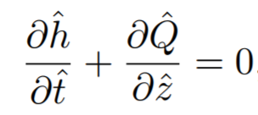
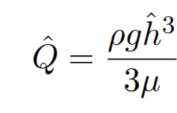
Spreading of liquid on a vertical liquid-coated wall
What type of equation is this?
First order hyperbolic equation
What extra conditions do we need to solve this?
One initial condition and one boundary condition
Notes:
Hats = dimensional variables
Label Q rho, g and mu
Conservative form
Add initial condition and boundary condition

Slide 4
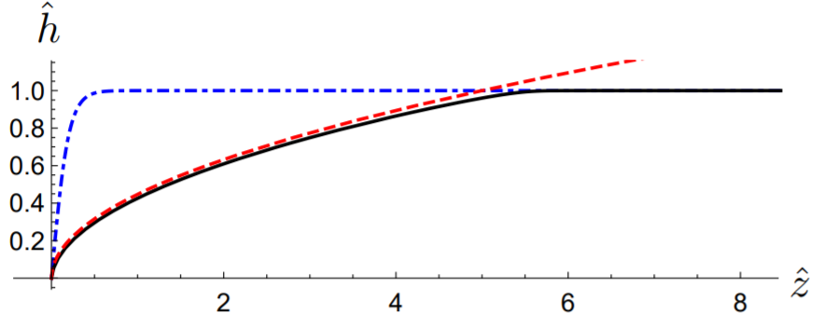
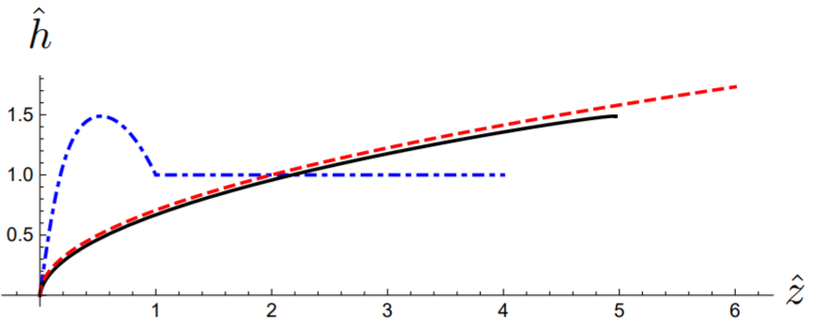
We can solve this problem analytically (see problem sheet 1).
For any initial condition, we appear to evolve to the same final shape.

Slide 5
Can we extract what this universal shape is?
First, non-dimensionalize:
There is no natural length or height scale.
We could chose these using the initial conditions, but there is nothing inherent in the problem to specify these.
Notes:
Write what t0 is

Slide 6
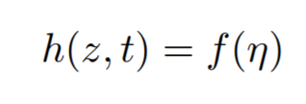
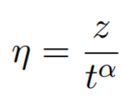
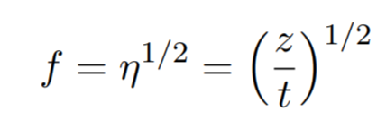
Try a solution of the form
Substituting in gives
If we choose α=1 then we turn the equation into one solely in terms of
Notes:
It is not obvious why we should try this on the face of it (we will find out later on) but for now we will just try this.

Slide 7
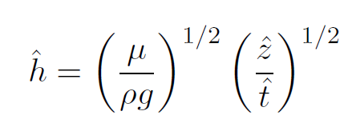
This is precisely the shape that we see all the profiles evolving towards.
However, in getting this solution, we did not use the initial condition to find this similarity solution. This highlights the fact that our similarity solution ‘forgets’ the initial information.
Although in our case we could obtain an analytic solution, in many cases we cannot.
This similarity solution provides key information about the system behaviour without having to solve the full equation.
Before we move onto the next example, we will show how we can predict the form of the similarity variables.
Notes:
It is not obvious why we should try this on the face of it (we will find out later on) but for now we will just try this.

Slide 8
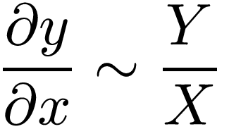
We approximate derivatives as
This is called a scaling law approach.
Substitute this into our partial differential equation:
Notes:
It is not obvious why we should try this on the face of it (we will find out later on) but for now we will just try this.

Slide 9
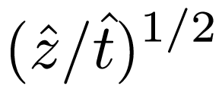
Rearranging gives
This has given us almost as much information as the similarity solution.
It gives us the right functional form and parametric dependence.
It doesn’t give us the right prefactor.
The scaling law gives the long time functional and parametric dependence.
The similarity solution gives the long time solution.
The analytic solution gives the correct behaviour for all time.
Notes:
It is not obvious why we should try this on the face of it (we will find out later on) but for now we will just try this.

Slide 10
Summary of lecture 1
Scaling laws can give the long time functional and parametric dependence
Similarity solutions give the long time solution
Analytic solutions give the correct behaviour for all time
Notes:
Show YouTube video of hydraulic jump in kitchen sink as an example of a similarity solution of the third kind.

Slide 11
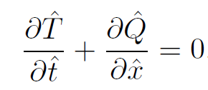
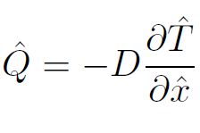
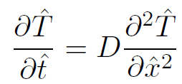
The heat equation
What kind of equation is this?
Second order parabolic equation.
What extra conditions do we need to solve this?
One initial condition and one boundary condition.
Notes:
It is not obvious why we should try this on the face of it (we will find out later on) but for now we will just try this.

Slide 12
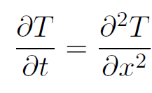
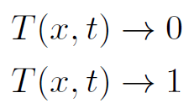
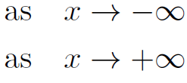
We non-dimensionalize the equation:
Notes:
It is not obvious why we should try this on the face of it (we will find out later on) but for now we will just try this.

Slide 13
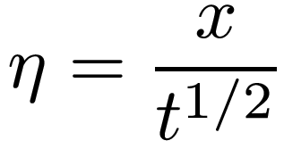
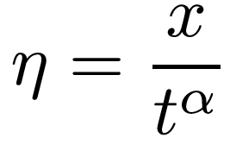
First let’s try the scaling argument:
This gives us that our similarity variable is but nothing more.
So this time we try a similarity solution of the form with
Notes:
It is not obvious why we should try this on the face of it (we will find out later on) but for now we will just try this.

Slide 14
Our governing equation and boundary conditions then become:
This has solution where
In terms of dimensional variables, this is
Notes:
It is not obvious why we should try this on the face of it (we will find out later on) but for now we will just try this.

Slide 15
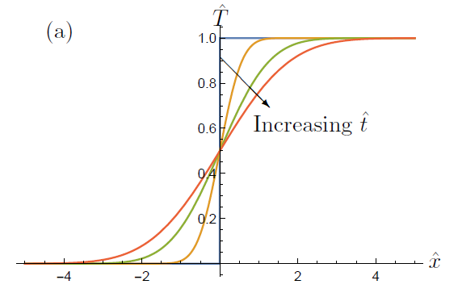
As in the previous example for flow down a vertical wall, we did not use the initial condition to obtain this solution, so the result only holds for long time…
…unless the initial condition happens to satisfy at t=0
Notes:
This means that we can collapse the data onto a single curve for any time

Slide 16
This example was fairly similar to the previous example. However, now let’s suppose that
In this case we must non-dimensionalize differently.
The dimensionless equation is the same as before but the boundary conditions are different:
Question: what happens if we try the same similarity ansatz as before?
Notes:
It is not obvious why we should try this on the face of it (we will find out later on) but for now we will just try this.

Slide 17
While this is seemingly similar to the previous problem, the similarity solution we tried before now simply gives the trivial solution.
We can see why by integrating the equation over the entire domain. This gives
If we substitute our similarity ansatz into this result we get
Notes:
It is not obvious why we should try this on the face of it (we will find out later on) but for now we will just try this.

Slide 18
This means we need to seek a more general similarity ansatz if we are to obtain a non-trivial solution.
We try with
Substituting into the governing equation and the energy constraint tells us that we need α=1/2 and β=1/2.
Then, we get
This has solution
Notes:
It is not obvious why we should try this on the face of it (we will find out later on) but for now we will just try this.

Slide 19
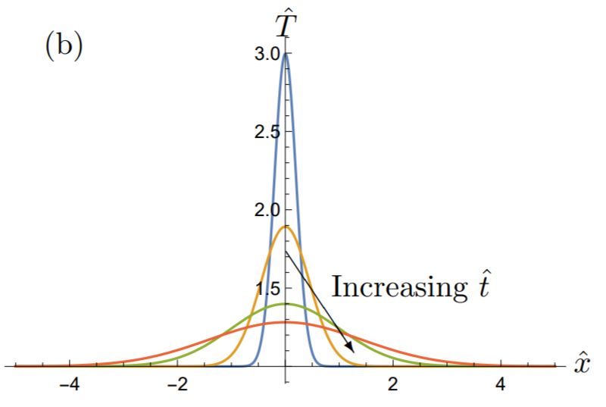
In original dimensional terms, this solution is
Again, we have not imposed an initial condition to obtain this result, but if our initial condition satisfied for t=0 then this would be the solution for all time.
But where did the similarity form come from?
Notes:
It is not obvious why we should try this on the face of it (we will find out later on) but for now we will just try this.

Slide 20
If we make a transformation
and substitute into the equation and boundary condition then we find that if then the equations in terms of the new variables are identical.
This indicates that and are invariants of the system.
This tells us that the solution depends on and has the form
which is exactly what we have seen.
Notes:
It is not obvious why we should try this on the face of it (we will find out later on) but for now we will just try this.

Slide 21
Summary of lecture 2
We can get different similarity solutions from the same equation by applying different boundary conditions.
Invariants of the system tell us the form of the similarity solution.
Notes:
It is not obvious why we should try this on the face of it (we will find out later on) but for now we will just try this.

Slide 22
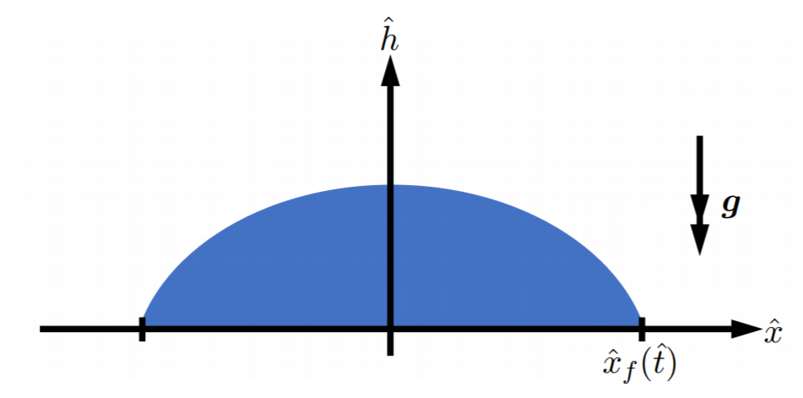
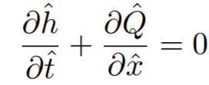
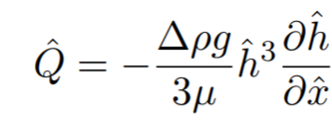
Spreading of liquid on a horizontal plate

Slide 23
(1)
What extra conditions do we need to solve this?
One initial condition and two boundary conditions
One boundary condition is (A)

Slide 24
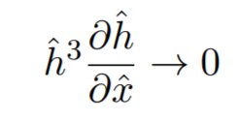
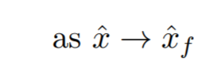
Volume conservation: (B)
The final condition to close the system is (C)

Slide 25
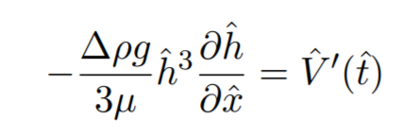
For numerics it can be easier to work with boundary conditions rather than integral constraints like (B) and regularity conditions like (C).
But we can transform (B) and (C) into boundary conditions.
We integrate (1) over and apply (B) and (C) to get
(B1)

Slide 26
Now rescale into a local region near the moving front:
And rescale the height:
Then (1) becomes
At leading order this gives

Slide 27
Integrating gives
In terms of the original variables this gives
(C1)
(B1) and (C1) are easier boundary conditions for numerics than (B) and (C).

Slide 28
Here we will study just
Analytical solutions are not possible so we proceed directly to the similarity solution.
A scaling law analysis gives
This scaling law gives the parametric dependence.

Slide 29
Now consider the full similarity solution.
First, non-dimensionalize:

Slide 30
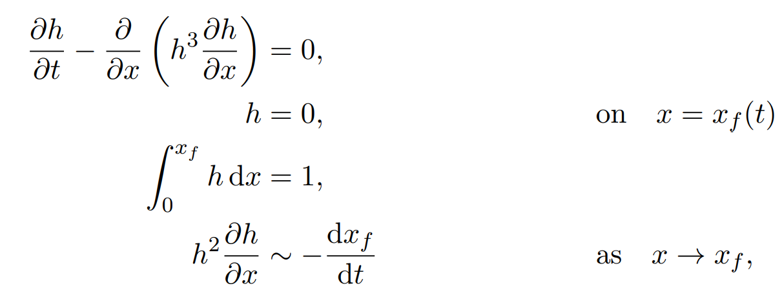
Dimensionless problem:

Slide 31
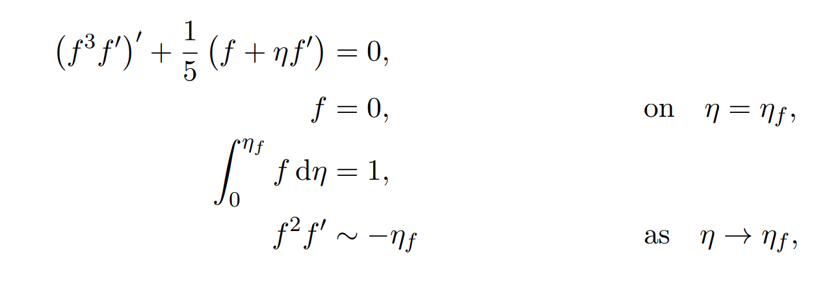
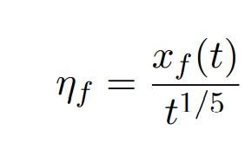
Dimensionless problem:
with

Slide 32
A final change of variable decouples the spreading domain:
This leads to the system

Slide 33
The solution to this system is

Slide 34
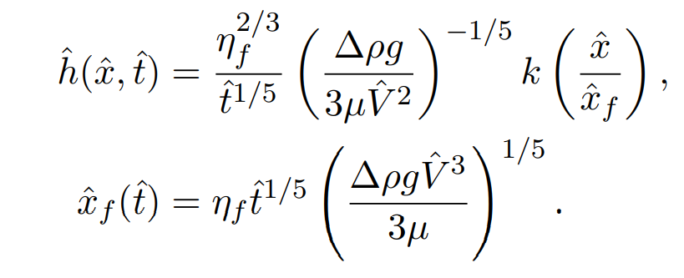
In dimensional terms:
The scaling analysis provided the time dependence and the parametric dependence but lacked the shape that this similarity solution provides.

Slide 35
In all the examples we have considered so far we have been able to determine the form of the required solution by a scaling argument.
Examples of this kind are called similarity solutions of the first kind.
We will now consider an example where scaling analysis alone does not determine the solution.
These are called similarity solutions of the second kind.

Slide 36
Summary of lecture 3
Spreading of liquid on a horizontal plate.
We use the governing equation and mass conservation to determine the similarity solution.
The position of the front is also an unknown we must solve for.
We can transform the mass-conservation integral relation into a boundary condition.
We can transform the regularity condition at the moving front into a boundary condition.
We scale the variables so that we solve for the height of the profile first and determine the position of the front afterwards.

Slide 37
Spreading of a groundwater mound
Now let’s consider the spreading in a porous medium rather than in air:
Suppose that the liquid leaves behind a residue.

Slide 38
Spreading of a groundwater mound
Now let’s consider the spreading in a porous medium rather than in air:
Suppose that the liquid leaves behind a residue.

Slide 39
We now split up the problem into two regions.
Region 1: Liquid invading dry porous medium
Here the flow is governed by the porous medium equation

Slide 40
Region 2: Liquid draining
Here the flow is governed by a modified porous medium equation due to the partially saturated residue region:
s = fraction of space occupied by liquid in drained region. s = 0 recovers the original porous medium equation. As s increases, gets larger due to the liquid in the drained region pushing down.

Slide 41
Denote the position of the front by and the position of the joint separating Regions 1 and 2 by .
We have two second-order partial differential equations with two additional unknowns ( and ) so we require initial conditions for the two regions plus six boundary conditions (four for the two equations and two for the unknowns).

Slide 42
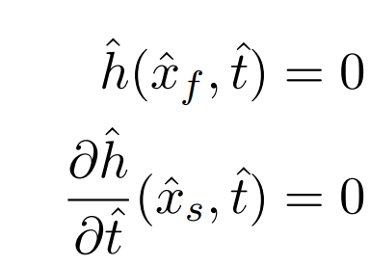
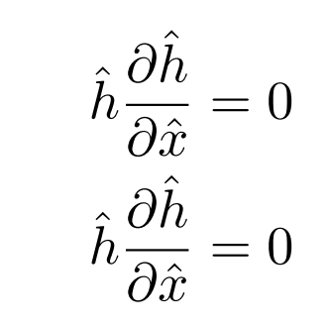
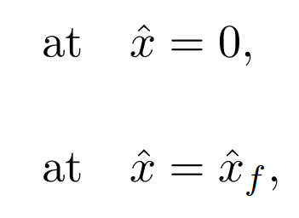
We apply:
Definition of
Definition of
No flux at the centre
No flux at the front
Continuity in and at the joint

Slide 43
As for the case of a spreading liquid, (D) doesn’t look like it gives any more information than (A). However, it does enforce a regularity condition on at the front.
We can transform this into a stronger condition by performing a local analysis near the front. We rescale:
Substituting into (1) and considering the result at leading order gives
which in terms of the original variables gives

Slide 44
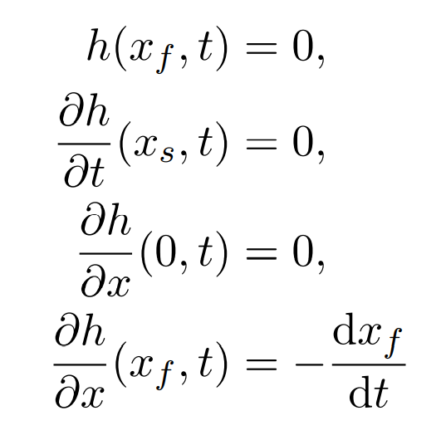
We non-dimensionalize via
The resulting dimensionless system is then
(1)
(2)
(A)
(B)
(C)
(D)
plus continuity in (E)

Slide 45
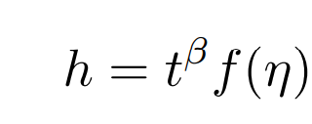
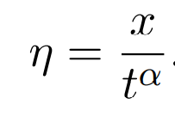
Since the liquid leaves behind a residue we can’t apply a simple global conservation law like in previous cases.
We try a similarity solution of the form with
This gives

Slide 46
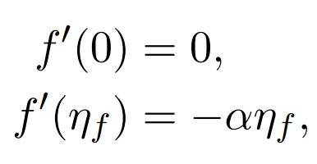
We also apply as well as continuity in f and f’ at .
Unlike in our previous examples, we have no further information to determine α. So, we press on.

Slide 47
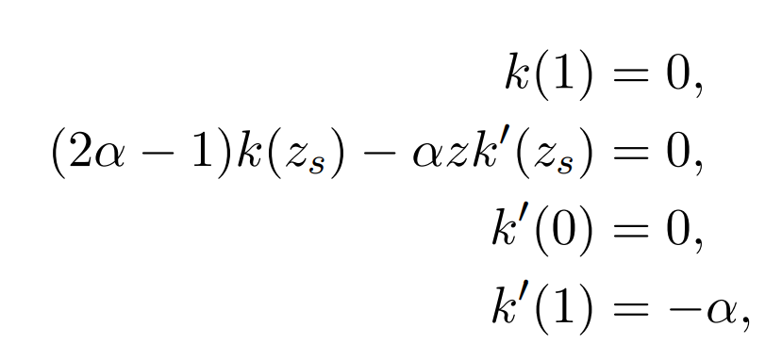
Make a change of variable
And continuity in k and k’ at z=z_{s}.
This is two second-order ordinary differential equations plus one unknown (z_{s}).
How many boundary conditions does this require?

Slide 48
We have six boundary conditions. The sixth condition determines α.
This is an eigenvalue problem.
For a given value of κ there is an associated α that gives a solution.
The natural similarity variables did not emerge from a scaling argument but instead as part of the solution.
Such problems are called similarity solutions of the second kind.

Slide 49
Importantly, in this case, the similarity solution only provides the shape of the interface up to a constant. Our final scaling moved the unknown η_{s} to determine α so we are still missing one pieced of information. (In our previous example of spreading liquid on a horizontal plate, this came from mass conservation.)
To determine the appropriate scaling we must compare our similarity solution with the full numerical solution at one point in time.

Slide 50
Summary
Scaling laws can provide a significant amount of information about the solution of a partial differential equation system.
Similarity solutions of the first kind provide the full behaviour for long time but does not (always) capture the early-time behaviour (unless this happens to satisfy the initial condition).
Similarity solutions of the second kind arise when we cannot fully determine the form of the similarity solution from the governing equation and boundary conditions. This forms an eigenvalue problem. The similarity solution provides the shape up to a scaling constant.

Slide 51
Summary of lecture 4
Similarity solutions of the second kind arise when we cannot fully determine the form of the similarity solution from the governing equation and boundary conditions.
This forms an eigenvalue problem.
The similarity solutions provides the shape up to a scaling constant.

Slide 52
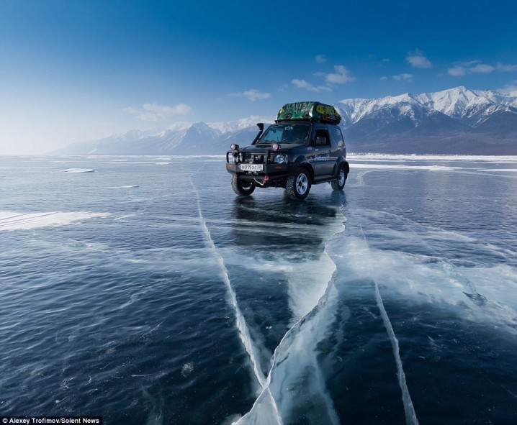
Free boundary problems
A free boundary problem occurs when the region in which the problem is to be solved is unknown in advance and must be found as part of the solution.
One relevant example for the current weather concerns the freezing or melting of ice. Here, we have to solve for the free boundary between the two phases as well as for the temperature field in each phase.

Slide 53
The shape of a free boundary as it is formed can be quite exotic.

Slide 54
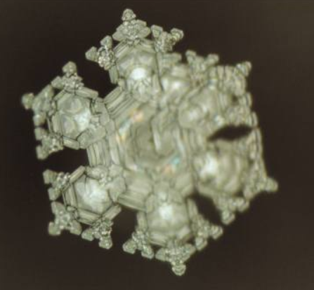
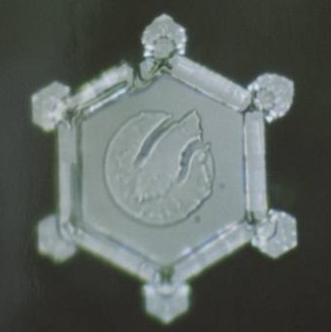
Masaru Emoto
Mount Cook Glacier, New Zealand
Shimanto River, Japan

Slide 55
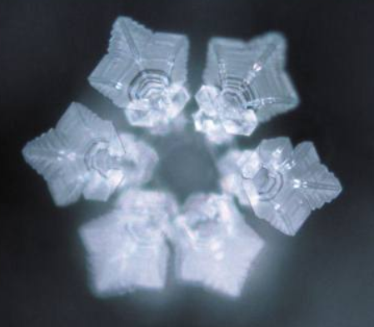
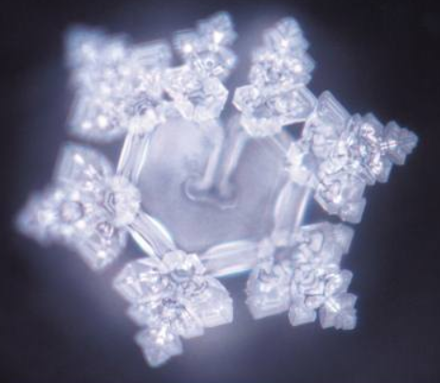
Playing Imagine by John Lennon to the water
Showing the water a photo of an elephant

Slide 56
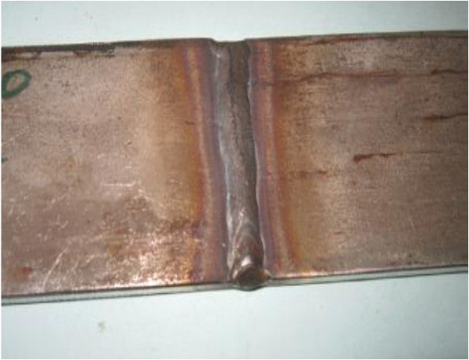
Industrial problem: electric welding
Steel plates are welded together by attaching electrodes to the edges and then passing a current through.
This heats the metal, causing the plates to melt. When the current is switched off, the liquid metal solidifies and the two plates are welded together.
How long should the current be applied to ensure the metal melts without melting the entire plates?
How long should the plates be left once the current has been switched off to ensure that they have solidified completely?

Slide 57
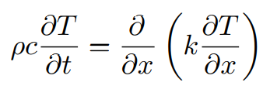
One-dimensional Stefan problem
Consider a slab of initially solid material occupying the region 0 < x < a. The temperature T(x,t) in the slab satisfies the heat equation:
Suppose the slab is initially at a uniform temperature T₀ and the face x = a is insulated, while the temperature of the face at x = 0 is suddenly increased to a temperature T₁ > T₀:
If T₁ is high enough the solid will melt and become liquid in some neighbourhood of x = 0.

Slide 58
If the slab melts, we must seek a solution in which the slab is liquid in 0 < x < s(t) and solid in s(t) < x < a, where x = s(t) is the free boundary separating the liquid and solid phases.
s(t) is unknown in advance and must be found as part of the solution.
We have to solve the heat equation in both solid and liquid phases, with different values of the parameters ρ, c and k in each phase.
We also need to impose conditions at the free boundary x = s(t).

Slide 59
First we assume that the phase change happens at a known melting temperature so
Since the temperature is continuous, this applies on both sides of the free boundary.

Slide 60
The second condition comes from an energy balance. At a fixed boundary, the heat flux coming in from one side must equal the heat flux exiting from the other side, i.e., q = −k∂T /∂x must be continuous.
However, at a moving interface, we must also consider the energy associated with the phase change, known as the latent heat L.
The latent heat acts as an energy source or sink at a moving solid–liquid interface, and the resulting boundary condition
This is called the Stefan condition.

Slide 61
Assumptions
We assumed that the heat flux is purely due to thermal conductivity. If the liquid flows at all, then there will also be a contribution due to convection.
We assumed that the solid and liquid have the same density. If there is a change in density as the material melts, this would induce a velocity.

Slide 62
Summary of lecture 5
A free boundary problem occurs when the region in which the problem is to be solved is unknown in advance and must be found as part of the solution.
Stefan problems describe melting or freezing. At the interface we apply a Stefan condition:
A one-phase Stefan problem considers solid at the melting point and describes the temperature of the liquid.

Slide 63
One-phase Stefan problem
Assume that ρ, c and k are all constant on either side of the solid–liquid interface.
Suppose that the initial temperature T₀ is equal to the melting temperature T_{m}. This means that the solid region s(t) < x < a is always at temperature T_{m} and we only need to solve the heat equation in the liquid phase 0 < x < s(t).
This is a one-phase Stefan problem.

Slide 64
Non-dimensionalize:
Notes:
Define St

Slide 65
Seek a similarity solution:
Notes:
Define St

Slide 66
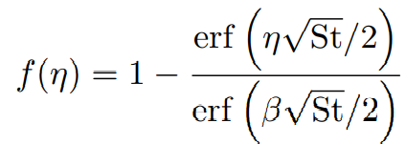
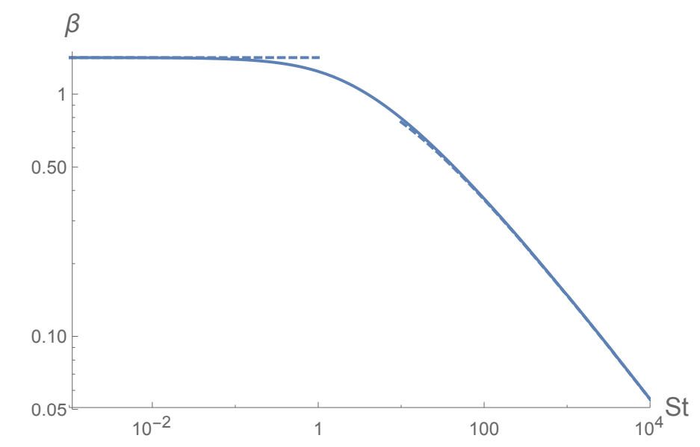
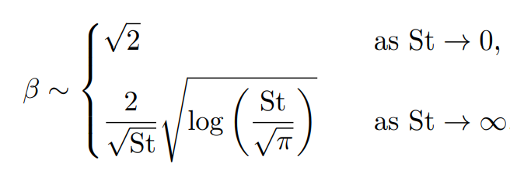
The solution is
Notes:
St<<1 works for up to St=1 so does a good job

Slide 67
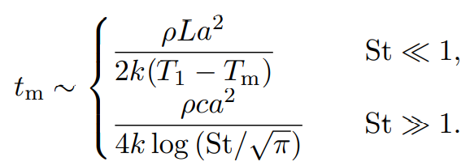
The entire slab has melted when s(t) = 1, and the dimensionless time taken is thus given by 1/β².
By reversing the non-dimensionalization we find approximations for the melting time t_{m}:
When St<<1, the melting of the slab is limited by the latent heat required.
When St>>1, the main barrier is the energy needed to heat up the slab, and the melting time depends only weakly on the latent heat L.
Notes:
Define St

Slide 68
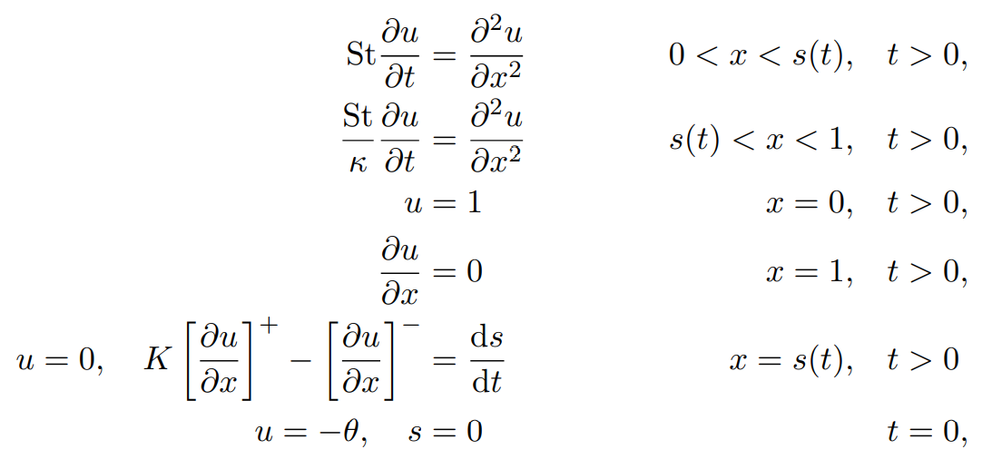
Two-phase Stefan problem

Slide 69
When St<<1:
( )
*
This is equivalent to the one-phase small St Stefan problem ( )

Slide 70
The approximate solution (*) does not satisfy the initial condition (except in the special case when θ = 0, i.e., T₀ = T_{m}).
We resolve this by considering a small-t boundary layer in which u adjusts from the initial value −θ to the outer solution.

Slide 71
Two-dimensional Stefan problem
We study the small Stefan number limit again: St<<1.
We then have a Hele-Shaw problem.
Notes:
Finally, the Stefan condition now relates the normal velocity Vn of the free boundary to the jump in the normal derivative of the temperature on either side. To close the problem, it only remains to specify suitable initial conditions, namely the value of the temperature everywhere in the domain and the position of the free boundary at t = 0.

Slide 72
We examine the linear stability.
For simplicity, consider the one-phase Stefan problem again so u₂=0.
Assume that the interface is moving at speed V and there is a temperature gradient -λ. (We expect λ>0 if the left region is liquid and the right is solid.) The solution is then
Consider a small perturbation about this solution

Slide 73
Substitute into the Stefan condition:
Substitute into the governing equations

Slide 74
Try a wave-like solution: Here, k is the wavenumber and σ is the linear growth rate.
Substituting into the governing equations gives the linear system
Non-trivial solutions require the determinant of the matrix to be zero, giving

Slide 75
If V>0
The solid is melting.
σ<0 and so the perturbations decay with time – the interface is stable.
If V<0
The liquid is freezing.
σ>0 and so the perturbations grow with time – the interface is unstable.
The smallest wavelength modes grow the fastest – this is an ill-posed problem.
The solution does not depend continuously on the data.
an arbitrarily small perturbation of the initial conditions may cause an arbitrarily large change in the solution.
This is physically unacceptable, and such ill posed problems are also effectively impossible to solve numerically.
λ<0 which means that the temperature in the liquid is lower than the melting temperature. The liquid is supercooled.

Slide 76
The results we have found tie in with what we observe physically
An ice cube melts smoothly in a drink.
But as water freezes, dendrites form whose structure are unpredictable.

Slide 77
Summary of lecture 6
Two-dimensional Stefan problem
Linear stability demonstrates that:
solid melting is stable
liquid freezing is unstable – this is an ill-posed problem.
We need a model for liquid freezing.

Slide 78
It is reasonable for a freezing boundary to be unstable, but it is not acceptable for the problem to be ill posed.
Some additional physics must become important to regularize the problem by suppressing arbitrarily high wavenumbers, e.g.,:
Surface energy effects penalise high curvature variations in the free boundary.
Kinetic undercooling – the temperature need not be continuous if the free boundary evolves rapidly enough to be out of thermodynamic equilibrium.
Model the complex dendrites.
But we shall choose a simpler strategy – to model the dendritic region as a “mushy region”

Slide 79
One-dimensional welding problem
T=T₀<T_{m}
T=T₀<T_{m}
0
Assume that the parameters ρ, c, k and σ are constant and the same in both phases.
Assume symmetry about x=0.

Slide 80
Let’s draw how we expect the temperature to evolve:

Slide 81
This is an ill-posed problem.

Slide 82
What happens instead?
There is not a simple free boundary between pure liquid and pure solid phases.
Instead, there is a “mushy region” in which both solid and liquid phases coexist, with the solid existing in a very fine dendritic crystalline structure.
Rather than try to resolve this highly complicated structure, we construct a homogenised model that describes the net macroscopic behaviour of the mixture as a whole.

Slide 83
We have two free boundaries x = s₁(t) and x = s₂(t), with solid material in s₁ < x < a, mush in s₂ < x < s₁ liquid in 0 < x < s₂.
It just remains to construct a model for the mush.

Slide 84
The first observation is that, for both phases to coexist, the temperature must everywhere be close to the melting temperature, so we may set T = T_{m} in the mush.
The energy source does not heat up the mixture but supplies the latent heat needed to melt the solid.
The energy equation in the mush is (*) where θ is the liquid fraction in the mixture: θ = 0 in a pure solid and θ = 1 in pure liquid.

Slide 85
We have two free boundaries. The equation for conservation of energy at each of these is
Finally, we require one initial condition for the PDE (*), namely that θ is continuous across the advancing melting boundary x = s₁(t) (so that the liquid fraction is zero when the mush first forms.
Note that θ is not in general continuous at the mush-liquid boundary x = s₂(t).
j=1,2

Slide 86
The dimensionless problem we must work with is thus:
which describes the liquid and solid, and
which describes the mushy layer.

Slide 87
This modified free boundary problem is well posed.
In general, numerical solution is required. A very useful approach is to use the enthalpy, which measures the total internal energy in the material, including thermal energy and latent heat.
However, the initial stages at least may be analysed analytically, and in the quasi-steady limit St → 0 the problem may be solved completely.

Slide 88
Co-dimension two free boundary problems
In electrochemical painting, metal objects are coated using electrochemistry.
The object (“workpiece”) is immersed in an electrolyte solution, across which a potential difference V is imposed.
This drives a current j of ions which attach themselves as a layer of paint on the workpiece.
A model is needed to determine when (and if) the entire surface of the workpiece is covered in paint, and the thickness of the paint layer achieved.

Slide 89
Modelling assumptions
The concentration of ions in solution is sufficiently large that their depletion during the process is negligible. We may then treat the concentration as a constant.
The flux of ions in the solution due to the imposed electric field is then given by where φ is the electric potential and σ is the conductivity.
Conservation of charge then gives
We apply boundary conditions φ=-V on the workpiece and φ=0 on the outer surface.

Slide 90
Let h(x,t) denote the thickness of the paint layer (where it exists).
Assume the paint acts as a resistive layer with conductivity much lower than that of the solution. If the layer is thin, then it will act as a classical resistor with surface conductivity /h.
We can relate the potential difference across the layer to the current across it:
It is observed experimentally that, when the current is switched off, the paint dissolves back into solution at some rate d. So, where α = V_{M}/F, where V_{M} is the molar volume of solid paint and F is Faraday’s constant.

Slide 91
We non-dimensionalize via:
The boundary conditions then read
We exploit the smallness of ε and expand:
We can then replace the boundary condition above to apply on y=0.

Slide 92
In places where there is no paint (h=0) we apply

Slide 93
Summary of lecture 7
Solid melting is stable – a well-posed problem.
Liquid freezing is unstable – an ill-posed problem.
To model freezing we introduce a mushy region composed of liquid fraction θ and solid fraction 1-θ.
We solve for the temperature T in the solid and liquid regions and for θ in the mushy region.

Slide 94
Electrochemical painting – recap

Slide 95
The geometry to solve Laplace’s equation is specified in advance.
But the points x= ±c where the boundary conditions switch from Dirchlet to Neumann are not known in advance and must be found as part of the solution.
These points are the free boundaries.
This is called a codimension two free boundary problem because two is the codimension between the space in which the problem is posed (two dimensions) and the free boundaries (points, i.e., zero dimensions).

Slide 96
Consider the steady problem
We can solve for φ and then determine h after using the remaining boundary condition
Note that since h≥0 this means that φ(x,0)≥0.

Slide 97
Suppose that the earth is a single point at (0,1). Then the potential near this point is a point singularity with unit strength:

Slide 98
We subtract off the singularity, an image at (0,-1) and δy to satisfy the boundary condition ∂φ/∂y=δ on y=h:

Slide 99
The problem then reads:
where

Slide 100
This is a mixed boundary value problem. We expect the solution to have singularities at (±c,0) where the boundary conditions switch from Dirichlet to Neumann.
This problem can be solved by taking a Fourier transform in x, in terms of the function at the surface of the workpiece, ₀(x)= (x,0). Doing this, we find that

Slide 101
Carefully taking the limit y->0 and applying the boundary condition
we find that ₀ satisfies the singular integral equation:
Here we take the principal value of the integral:
We solve the for ₀(x), and find the value of c such that is differentiable at (±c, 0).
The thickness of the painted layer is then recovered from
Notes:
Principal value of integral

Slide 102
Solution of problem
The most elegant way to solve this problem is using complex variable theory.
We write
where w(z) is holomorphic in Im(z) > 0.
(The imaginary part is the harmonic conjugate to – they are related through the Cauchy–Riemann equations.)
We differentiate with respect to z:
Notes:
Principal value of integral

Slide 103
Our task is then to find a w’(z) that is holomorphic on the upper half plane and satisfies the conditions
The mixed character of the problem is reflected in the fact that we specify the real part of w’ in one place and the imaginary part in another.
Notes:
Principal value of integral

Slide 104
But we can use a trick to transform this into a problem for just the real part by letting where
The key point is that is real when x>c and imaginary when x<c as y->0 so W(z) stays real everywhere.
Notes:
Principal value of integral

Slide 105
The new function W satisfies a classical Dirichlet problem, satisfying Laplace’s equation with its real part specified everywhere on the boundary
(A)
(B)
The solution is given using Poisson’s formula:
Comparing (*) with (A) gives a relation between δ and c.

Slide 106
Taking the limit of our integral (*) as z->∞ and comparing with (A) gives
This tells us how the size of the painted region, 2c, depends on the control parameter δ

Slide 107
Using our result fo W and the definition of W, we can relate back to to get
The thickness profile is then given by

Slide 108
Useful texts for more reading and examples
I. Barenblatt, 1979, Similarity, Self-similarity and Intermediate Asymptotics, Consultants Bureau.
A.B. Tayler, 2001, Mathematical Models in Applied Mechanics. Oxford University Press.
S.C. Gupta, 2017, The Classical Stefan Problem: Basic Concepts, Modelling and Analysis with Quasi-analytical Solutions and Methods. Elsevier.

